Slide 1

Cloud Compute Services

Slide 2













AWS Compute Services
Amazon EC2
Amazon EC2 Auto Scaling
Amazon Elastic Container Registry (Amazon ECR)
Amazon Elastic Container Service (Amazon ECS)
VMware Cloud on AWS
AWS Elastic Beanstalk
AWS Lambda
Amazon Elastic Kubernetes Service (Amazon EKS)
Amazon Lightsail
AWS Batch
AWS Fargate
AWS Outposts
AWS Serverless Application Repository
Notes:
Amazon Web Services (AWS) offers many compute services. Here is a brief summary of what each compute service offers:
Amazon Elastic Compute Cloud (Amazon EC2) provides resizable virtual machines.
Amazon EC2 Auto Scaling supports application availability by allowing you to define conditions that will automatically launch or terminate EC2 instances.
Amazon Elastic Container Registry (Amazon ECR) is used to store and retrieve Docker images.
Amazon Elastic Container Service (Amazon ECS) is a container orchestration service that supports Docker.
VMware Cloud on AWS enables you to provision a hybrid cloud without custom hardware.
AWS Elastic Beanstalk provides a simple way to run and manage web applications.
AWS Lambda is a serverless compute solution. You pay only for the compute time that you use.
Amazon Elastic Kubernetes Service (Amazon EKS) enables you to run managed Kubernetes on AWS.
Amazon Lightsail provides a simple-to-use service for building an application or website.
AWS Batch provides a tool for running batch jobs at any scale.
AWS Fargate provides a way to run containers that reduce the need for you to manage servers or clusters.
AWS Outposts provides a way to run select AWS services in your on-premises data center.
AWS Serverless Application Repository provides a way to discover, deploy, and publish serverless applications.
This module will discuss details of the services that are highlighted on the slide.

Slide 3
Categorizing Compute Services
Services | Key Concepts | Characteristics | Ease of Use
Amazon EC2 | Infrastructure as a service (IaaS) Instance-based Virtual machines | Provision virtual machines that you can manage as you choose | A familiar concept to many IT professionals.
AWS Lambda | Serverless computing Function-based Low-cost | Write and deploy code that executes on a schedule or that can be triggered by events Use when possible (architect for the cloud) | A relatively new concept for many IT staff members, but easy to use after you learn how.
Amazon ECS Amazon EKS AWS Fargate Amazon ECR | Container-based computing Instance-based | Spin up and execute jobs more quickly | AWS Fargate reduces administrative overhead, but you can use options that give you more control.
AWS Elastic Beanstalk | Platform as a service (PaaS) For web applications | Focus on your code (building your application) Can easily tie into other services—databases, Domain Name System (DNS), etc. | Fast and easy to get started.
Notes:
You can think of each AWS compute service as belonging to one of four broad categories: virtual machines (VMs) that provide infrastructure as a service (IaaS), serverless, container-based, and platform as a service (PaaS).
Amazon EC2 provides virtual machines, and you can think of it as infrastructure as a service (IaaS). IaaS services provide flexibility and leave many of the server management responsibilities to you. You choose the operating system, and you also choose the size and resource capabilities of the servers that you launch. For IT professionals who have experience using on-premises computing, virtual machines are a familiar concept. Amazon EC2 was one of the first AWS services, and it remains one of the most popular services.
AWS Lambda is a zero-administration compute platform. AWS Lambda enables you to run code without provisioning or managing servers. You pay only for the compute time that is consumed. This serverless technology concept is relatively new to many IT professionals. However, it is becoming more popular because it supports cloud-native architectures, which enable massive scalability at a lower cost than running servers 24/7 to support the same workloads.
Container-based services—including Amazon Elastic Container Service, Amazon Elastic Kubernetes Service, AWS Fargate, and Amazon Elastic Container Registry—enable you to run multiple workloads on a single operating system (OS). Containers spin up more quickly than virtual machines, thus offering responsiveness. Container-based solutions continue to grow in popularity.
Finally, AWS Elastic Beanstalk provides a platform as a service (PaaS). It facilitates the quick deployment of applications that you create by providing all the application services that you need. AWS manages the OS, the application server, and the other infrastructure components so that you can focus on developing your application code.

Slide 4
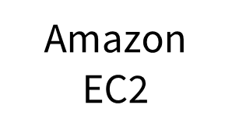
AWS EC2 Overview
Amazon Elastic Compute Cloud (Amazon EC2)
Provides virtual machines—referred to as EC2 instances—in the cloud.
Gives you full control over the guest operating system (Windows or Linux) on each instance.
You can launch instances of any size into an Availability Zone anywhere in the world.
Launch instances from Amazon Machine Images (AMIs).
Launch instances with a few clicks or a line of code, and they are ready in minutes.
You can control traffic to and from instances.

Slide 5











AWS EC2 Launch configuration
Amazon Machine Image (AMI)
Security group
Key pair
Instance type
Instance
Instance store or
Amazon EBS
VPC
Network placement
and addressing
User data
Assumed role
Notes:
Amazon Machine Image (AMI) – An AMI defines the base software configuration for an instance and is used by Amazon EC2 to launch the instance.
Instance type – An instance type defines a combination of CPU, memory, storage, and networking capacity that provides a certain level of compute capability to run an application.
Network placement and addressing – When you launch an instance, you can specify the appropriate network placement and addressing to provide the network access and security that you want.
Assumed role – Optionally, you can attach an AWS Identity and Access Management (IAM) role, which grants permissions for accessing AWS services to applications that run on the instance or users that are connected to the instance.
User data – You can further initialize or customize instance configuration by specifying a user data script. This script is automatically executed when the instance is launched.
Storage – You must specify the type of storage that will be used to store the root or boot volume of the instance.
Security group – You must also configure a new security group or use an existing one. The security group defines which ports network traffic is allowed on.
Key pair – A key pair is typically also specified at launch. The key pair is used for Secure Shell (SSH) connections or for establishing Remote Desktop Protocol (RDP) access to the instance.

Slide 6
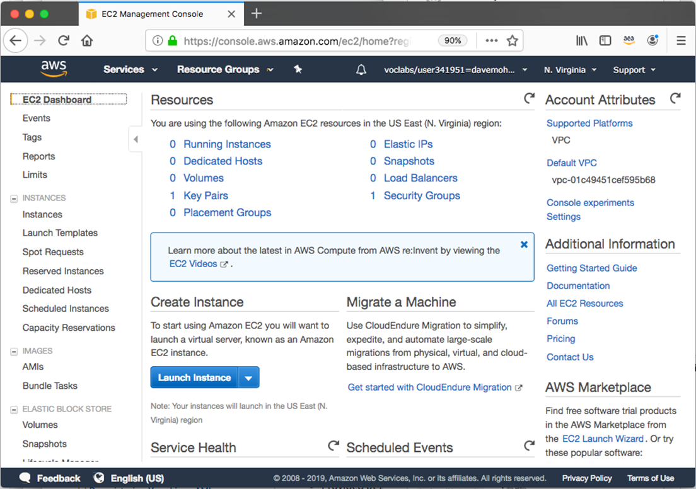
AWS EC2 Overview
Choices made using the Launch Instance Wizard:
AMI
Instance Type
Network settings
IAM role
User data
Storage options
Tags
Security group
Key pair

Slide 7
1. Select AMI
Launch
instance
AMI
Instance
Amazon Machine Image (AMI)
Is a template that is used to create an EC2 instance (which is a virtual machine, or VM, that runs in the AWS Cloud)
Contains a Windows or Linux operating system
Often also has some software pre-installed
AMI choices:
Quick Start – Linux and Windows AMIs that are provided by AWS
My AMIs – Any AMIs that you created
AWS Marketplace – Pre-configured templates from third parties
Community AMIs – AMIs shared by others; use at your own risk

Slide 8
2. Instance Type
The instance type that you choose determines
Memory (RAM)
Processing power (CPU)
Disk space and disk type (Storage)
Network performance
Instance type categories
General purpose
Compute optimized
Memory optimized
Storage optimized
Accelerated computing
Instance types offer family, generation, and size
Instance type naming
Example: t3.large
T is the family name
3 is the generation number
Large is the size
Instance Name | vCPU | Memory (GB) | Storage
t3.nano | 2 | 0.5 | EBS-Only
t3.micro | 2 | 1 | EBS-Only
t3.small | 2 | 2 | EBS-Only
t3.medium | 2 | 4 | EBS-Only
t3.large | 2 | 8 | EBS-Only
t3.xlarge | 4 | 16 | EBS-Only
t3.2xlarge | 8 | 32 | EBS-Only

Slide 9




AWS EC2 AMI instance types
 | General Purpose | Compute Optimized | Memory Optimized | Accelerated Computing | Storage Optimized
Instance Types | a1, m4, m5, t2, t3 | c4, c5 | r4, r5, x1, z1 | f1, g3, g4, p2, p3 | d2, h1, i3
Use Case | Broad | High performance | In-memory databases | Machine learning | Distributed file systems

Slide 10



Creating a new AMI: Example
AWS Cloud
Region A
Connect to the instance and manually modify it or run a script that modifies the instance (for example, upgrade installed software)
Quick Start or other
existing AMI
Launch an instance
Capture as a new AMI
Starter AMI
1
2
Modified
Instance
3
Unmodified
Instance
New AMI
(Optional) Import
a virtual machine
MyAMI
Region B
Copy the AMI to any other Regions where you want to use it
New AMI
4
Notes:
An AMI is created from an EC2 instance. You can import a virtual machine so that it becomes an EC2 instance, and then save the EC2 instance as an AMI. You can then launch an EC2 instance from that AMI. Alternatively, you can start with an existing AMI—such as of the Quick Start AMIs provided by AWS—and create an EC2 instance from it.
Regardless of which options you chose (step 1), you will have what the diagram refers to as an unmodified instance. From that instance, you might then create a golden instance—that is, a virtual machine that you configured with the specific OS and application settings that you want (step 2)—and then capture that as a new AMI (step 3). When you create an AMI, Amazon EC2 stops the instance, creates a snapshot of its root volume, and finally registers the snapshot as an AMI.
After an AMI is registered, the AMI can be used to launch new instances in the same AWS Region. The new AMI can now be thought of as a new starter AMI. You might want to also copy the AMI to other Regions (step 4), so that EC2 instances can also be launched in those locations.

Slide 11
AWS EC2 Image Builder
EC2 Image Builder automates the creation, management, and deployment of up-to-date and compliant golden VM images.
Provides a graphical interface to create image-building pipelines
Creates and maintains Amazon EC2 AMIs and on-premises VM images
Produces secure, validated, and up-to-date images
Enforces version control
EC2 Image Builder

Slide 12
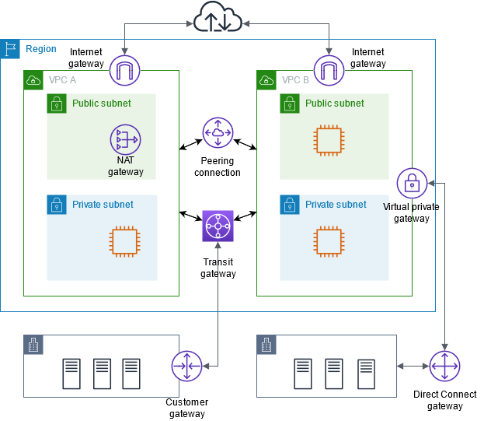
3. Networking ( VPC,Subnets, IPs etc.)
Region

Slide 13
3. Networking ( VPC,Subnets, IPs etc.)
Virtual Private Clouds

Slide 14
3. Networking ( VPC,Subnets, IPs etc.)
Subnetworks
Subnetworks

Slide 15
3. Networking ( VPC, Subnets, IPs etc.)
Gateways

Slide 16

4. Attached IAM role ( optional)
Will software on the EC2 instance need to interact with other AWS services?
If yes, attach an appropriate IAM Role.
An AWS Identity and Access Management (IAM) role that is attached to an EC2 instance is kept in an instance profile.
You are not restricted to attaching a role only at instance launch.
You can also attach a role to an instance that already exists.
Role that grants Amazon Simple Storage Service (Amazon S3) bucket access permissions
Application on instance can access
attached to
S3 bucket with objects
Instance
Notes:
Amazon Machine Image (AMI) – An AMI defines the base software configuration for an instance and is used by Amazon EC2 to launch the instance.
Instance type – An instance type defines a combination of CPU, memory, storage, and networking capacity that provides a certain level of compute capability to run an application.
Network placement and addressing – When you launch an instance, you can specify the appropriate network placement and addressing to provide the network access and security that you want.
Assumed role – Optionally, you can attach an AWS Identity and Access Management (IAM) role, which grants permissions for accessing AWS services to applications that run on the instance or users that are connected to the instance.
User data – You can further initialize or customize instance configuration by specifying a user data script. This script is automatically executed when the instance is launched.
Storage – You must specify the type of storage that will be used to store the root or boot volume of the instance.
Security group – You must also configure a new security group or use an existing one. The security group defines which ports network traffic is allowed on.
Key pair – A key pair is typically also specified at launch. The key pair is used for Secure Shell (SSH) connections or for establishing Remote Desktop Protocol (RDP) access to the instance.

Slide 17
5.User Data ( Optional)
Optionally specify a user data script at instance launch
Use user data scripts to customize the runtime environment of your instance
Script executes the first time the instance starts
Can be used strategically
For example, reduce the number of custom AMIs that you build and maintain
User data
#!/bin/bash
yum update –y
yum install -y wget
AMI
Running EC2 instance
Notes:
User data – You can further initialize or customize instance configuration by specifying a user data script. This script is automatically executed when the instance is launched.

Slide 18



6. EC2 Storage Options
Root volume
Data volumes
This volume always contains the guest OS
For data accessed by a single instance
Instance store
Amazon EBS (SSD-backed only)
Instance store
Amazon EBS
For data accessible from multiple instances
An EC2 instance will always have a root volume, and can optionally have one or more data volumes.
Amazon Elastic File System (Amazon EFS) [Linux]
Amazon FSx for Windows File Server

Slide 19
6. EC2 Storage Options
An instance store provides non-persistent storage to an instance –
The data is stored on the same physical server where the instance runs
Characteristics –
Temporary block-level storage
Uses HDD or SSD
Instance store data is lost when the instance is stopped or terminated
Example use cases –
Buffers
Cache
Scratch data
Instance 1
Instance 2
Ephemeral
0
Ephemeral
1
Ephemeral
2
Instances
Instance store
Physical host computer in AWS

Slide 20
6. EC2 Storage Options
Amazon Elastic Block Store (Amazon EBS) –
Durable, block-level storage volumes.
You can stop the instance and start it again, and the data will still be there.
Amazon EC2 Instance Store –
Ephemeral storage is provided on disks that are attached to the host computer where the EC2 instance is running.
If the instance stops, data stored here is deleted.
Other options for storage (not for the root volume) –
Mount an Amazon Elastic File System (Amazon EFS) file system.
Connect to Amazon Simple Storage Service (Amazon S3).
Notes:
Amazon Elastic Block Store (Amazon EBS) is an easy-to-use, high-performance durable block storage service that is designed to be used with Amazon EC2 for both throughput- and transaction-intensive workloads. With Amazon EBS, you can choose from four different volume types to balance the optimal price and performance. You can change volume types or increase volume size without disrupting your critical applications, so you can have cost-effective storage when you need it.
Amazon EC2 Instance Store provides ephemeral, or temporary, block-level storage for your instance. This storage is located on disks that are physically attached to the host computer. Instance Store works well when you must temporarily store information that changes frequently, such as buffers, caches, scratch data, and other temporary content. You can also use Instance Store for data that is replicated across a fleet of instances, such as a load balanced pool of web servers. If the instances are stopped—either because of user error or a malfunction—the data on the instance store will be deleted.
Amazon Elastic File System (Amazon EFS) provides a simple, scalable, fully managed elastic Network File System (NFS) file system for use with AWS Cloud services and on-premises resources. It is built to scale on-demand to petabytes without disrupting applications. It grows and shrinks automatically as you add and remove files, which reduces the need to provision and manage capacity to accommodate growth.
Amazon Simple Storage Service (Amazon S3) is an object storage service that offers scalability, data availability, security, and performance. You can store and protect any amount of data for a variety of use cases, such as websites, mobile apps, backup and restore, archive, enterprise applications, Internet of Things (IoT) devices, and big data analytics.

Slide 21
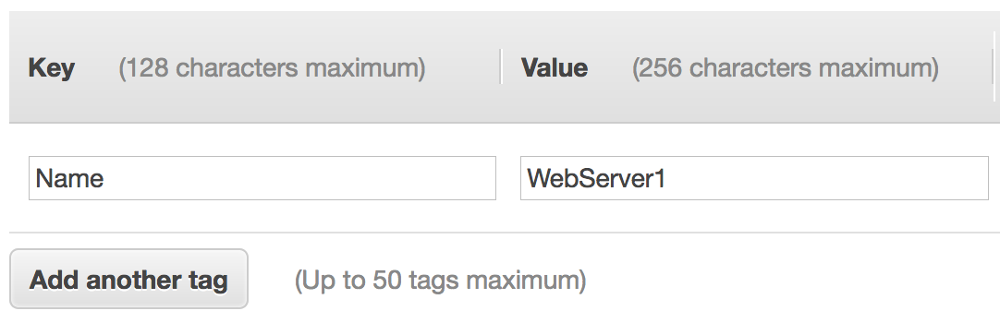
7. Tagging ( Optional)
A tag is a label that you can assign to an AWS resource.
Consists of a key and an optional value.
Tagging is how you can attach metadata to an EC2 instance.
Potential benefits of tagging—Filtering, automation, cost allocation, and access control.

Slide 22
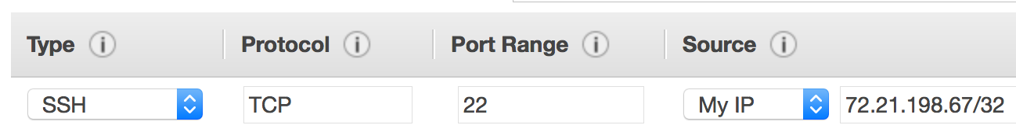
8. Security Groups
A security group is a set of firewall rules that control traffic to the instance.
It exists outside of the instance's guest OS.
Create rules that specify the source and which ports that network communications can use.
Specify the port number and the protocol, such as Transmission Control Protocol (TCP), User Datagram Protocol (UDP), or Internet Control Message Protocol (ICMP).
Specify the source (for example, an IP address or another security group) that is allowed to use the rule.
Example rule:

Slide 23
9. The Key Pairs
At instance launch, you specify an existing key pair or create a new key pair.
A key pair consists of –
A public key that AWS stores.
A private key file that you store.
It enables secure connections to the instance.
For Windows AMIs –
Use the private key to obtain the administrator password that you need to log in to your instance.
For Linux AMIs –
Use the private key to use SSH to securely connect to your instance.
Notes:
Amazon EC2 uses public–key cryptography to encrypt and decrypt login information. The technology uses a public key to encrypt a piece of data, and then the recipient uses the private key to decrypt the data. The public and private keys are known as a key pair. Public-key cryptography enables you to securely access your instances by using a private key instead of a password.
When you launch an instance, you specify a key pair. You can specify an existing key pair or a new key pair that you create at launch. If you create a new key pair, download it and save it in a safe location. This opportunity is the only chance you get to save the private key file.
To connect to a Windows instance, use the private key to obtain the administrator password, and then log in to the EC2 instance's Windows Desktop by using Remote Desktop Protocol (RDP). To establish an SSH connection from a Windows machine to an Amazon EC2 instance, you can use a tool such as PuTTY, which will require the same private key.
With Linux instances, at boot time, the public key content is placed on the instance. An entry is created in within ~/.ssh/authorized_keys. To log in to your Linux instance (for example, by using SSH), you must provide the private key when you establish the connection.

Slide 24
EC2 Life Cycle
Amazon EBS-backed instances only
Launch
Pending
Start
AMI
Rebooting
Reboot
Running
Stop
Stop-Hibernate
Stopping
Stopped
Terminate
Shutting down
Terminated
Terminate
Notes:
This diagram shows the lifecycle of an instance and highlights the extra actions and states that an Amazon EBS-backed instance allows.
When an instance is first launched from an AMI, or when you start a stopped instance, it enters the pending state. This state indicates that the instance is being provisioned on a host computer and is booting. The instance type that is specified in the AMI, or for the original stopped instance, determines the hardware of the host computer for the new instance.
When the instance is fully booted and ready, it exits the pending state and enters the running state. At this point, you can connect to your running instance over the internet and start to use it.
As soon as an instance is in a running state, it can be rebooted by using the Amazon EC2 console, the AWS Command Line Interface (AWS CLI), or AWS SDKs. It then moves to a rebooting state. A rebooted instance stays on the same physical host, and it maintains the same public Domain Name System (DNS) name and public IP address. If the instance has instance store volumes, it retains the data on those volumes.
From the running state, you can also terminate an instance. Terminating an instance causes the instance to go into an intermediary shutting down state before it displays a terminated state. A terminated instance remains visible in the Amazon EC2 console for some time before the virtual machine is deleted. However, you can’t connect to or recover a terminated instance.
Instances that are backed by Amazon EBS can also be stopped from a running state. They enter the stopping state before they attain the fully stopped state. A stopped instance does not incur the same cost as a running instance. Starting a stopped instance puts it back into the pending state, which moves the instance to a new host machine.
You can also hibernate an EBS-backed instance from the running state. Doing so causes the in-memory storage, private IP address, and Elastic IP address to be saved. They remain the same when you start the instance again, so you can pick up where you left off. In most cases, when you start a hibernated instance, it is moved to a new host computer. However, your instance might stay on the same host computer if the host computer has no problems.

Slide 25

Placement Group
A partition placement group spreads instances across logical partitions to reduce the likelihood of correlated hardware failure.
Cluster placement groups provide low-latency and high packet-per-second network performance between instances in the same Availability Zone.
They influence where a group of interdependent instances
Placement group can be in Cluster ,Partition or Spread
Availability Zone 1
Availability Zone 1
Availability
Zone 1
Availability Zone 2
Cluster placement group
Partition 1
Partition 2
Partition 3
Rack 1
Rack 2
Rack 3
Instances
Instances
Instances
Instances
Instance 1
Instance 2
Instance 3

Slide 26
EC2 Pricing Options
On-Demand Instances
Pay for compute capacity by the second or by the hour with no long-term commitments.
Spiky workloads, workload experimentation
Reserved Instances
Make a 1-year or 3-year commitment and receive a significant discount off on-demand prices.
Committed and steady-state workloads
Savings Plans
Same discounts as Reserved Instances with more flexibility in exchange for a $/hour commitment.
All Amazon EC2, AWS Fargate, and AWS Lambda workloads
Notes:
AWS offers five ways to pay for Amazon EC2 instances: On-Demand Instances, Reserved Instances, Savings Plans, Spot Instances, and Dedicated Hosts. The first three options are identified in this slide, and the last two are described in the next slide.
On-Demand Instances offer the most flexibility, with no long-term contract and low rates. They are a good choice for applications with short-term, spiky, or unpredictable workloads. They are also suited for developing and testing applications on Amazon EC2 for the first time. With On-Demand Instances, you pay for compute capacity by the hour or by the second, depending on which instances you run. On-Demand Instances have the lowest upfront cost and the most flexibility. They require no upfront commitments or long-term contracts.
Reserved Instances enable you to reserve computing capacity for a 1-year or 3-year term with lower hourly running costs. The discounted usage price is fixed for as long as you own the Reserved Instance. Reserved Instances are a good choice if you have predictable or steady-state compute needs (for example, an instance that you know you want to keep running most or all the time for months or years). If you expect consistent, heavy use, they can provide substantial savings compared to On-Demand Instances.
Savings Plans is a flexible pricing model that offers low prices on Amazon EC2, AWS Lambda, and AWS Fargate usage, in exchange for a commitment to a consistent amount of usage (measured in dollars per hour) for a 1-year or 3-year term. It offers lower prices on EC2 instance usage compared to On-Demand Instances, regardless of instance family, size, operating system, tenancy, or AWS Region. Each type of compute usage has an On-Demand Instance rate and a Savings Plans price. You can get started with Savings Plans from AWS Cost Explorer in the console or by using the API or the AWS CLI.

Slide 27

EC2 Pricing Options
Spot Instances
Spare Amazon EC2 capacity at substantial savings off On-Demand Instance prices.
Fault-tolerant, flexible, stateless workloads
Dedicated Hosts
Physical server with Amazon EC2 instance capacity fully dedicated for your use.
Workloads that require the use of your own software licenses or single tenancy to meet compliance requirements
Notes:
This slide lists the final two Amazon EC2 purchase options. They are Spot Instances and Dedicated Hosts.
Spot Instances enable you to bid on unused EC2 instances and request spare computing capacity at substantial savings. They are recommended for fault-tolerant, flexible (non-time-critical), stateless workloads. To use a Spot Instance, your workload must have the ability to be stopped and restarted: Amazon EC2 can interrupt it with a 2-minute notification to meet other capacity requirements. Your Spot Instance runs when capacity is available and the maximum price per hour for your request exceeds the Spot Instance price. Spot Instances are billed on 1-second increments, with a minimum of 60 seconds, if they are running the Amazon Linux or Ubuntu operating system. All other operating systems are billed in 1-hour increments, rounded up to nearest hour.
A variation of Spot Instances, called Spot blocks, enables you to run a workload continuously for a finite duration of 1–6 hours. Spot blocks are designed to not be interrupted and will run continuously for the duration you select, independent of the Spot Instance market price.
Dedicated Hosts are physical servers with instance capacity that is dedicated to your use. They are physically isolated at the level of the host hardware from instances that belong to other AWS accounts. Dedicated Hosts are a good choice when you have licensing restrictions for the software that you want to run on Amazon EC2, or when you have specific compliance or regulatory requirements that preclude you from using other deployment options.

Slide 28
EC2 Pricing Options
Automatic instance placement
Dedicated Hosts
Visibility of sockets, cores, and host ID
Affinity between a host and an instance
Targeted instance placement
Add capacity by using an allocation request
Per-instance billing
Per-host billing
Benefit – Isolates the hosts that run your instances
Benefit – Enables you to use your server-bound software licenses and address compliance requirements
Dedicated Instances
Notes:
You can use Dedicated Hosts and Dedicated Instances to launch EC2 instances on physical servers that are dedicated for your use. Both options enable you to isolate the hosts that run your instances from the hosts that run instances for other accounts. They also provide the same performance, security, and physical features.
Dedicated Hosts give you visibility and control over how instances are placed on a physical server. You can consistently deploy your instances to the same physical server over time. As a result, Dedicated Hosts enable you to use your existing server-bound software licenses, and to address corporate compliance and regulatory requirements.
Both options differ in the way they are billed. A Dedicated Instance is billed per instance, and its pricing has two components. The two components are an hourly per-instance usage fee and a dedicated per-Region fee that you pay once per hour, regardless of how many Dedicated Instances are running.
A Dedicated Host is billed per host. You can choose from three different pricing models to pay for Dedicated Hosts: On-Demand, Reservation Pricing, and Savings Plans.
To indicate that an instance should run as a Dedicated Instance or a Dedicated Host, change the instance’s tenancy attribute to dedicated or host, respectively. For more information, see Amazon EC2 Dedicated Hosts.

Slide 29
Questions ?

